Slide 1
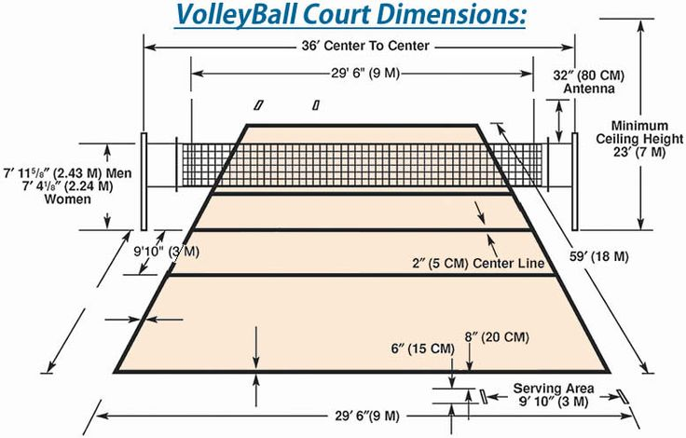
Volleyball Pitch

Slide 2
Type of Volleyball courts
There are two types of volley ball courts
1. Indoor
2.Outdoor

Slide 4
double play court
A double occurs in volleyball when a player, during a match, is credited with scoring at least ten times in one (or more) of five statistical categories: aces, kills, blocks, digs, and assists.

Slide 5
mixed play court
Male and female players together in a team supporting each other to keep the ball alive before making an attack, just like ordinary volleyball.

Slide 6
26t*50sqrt Total area court design

Slide 7
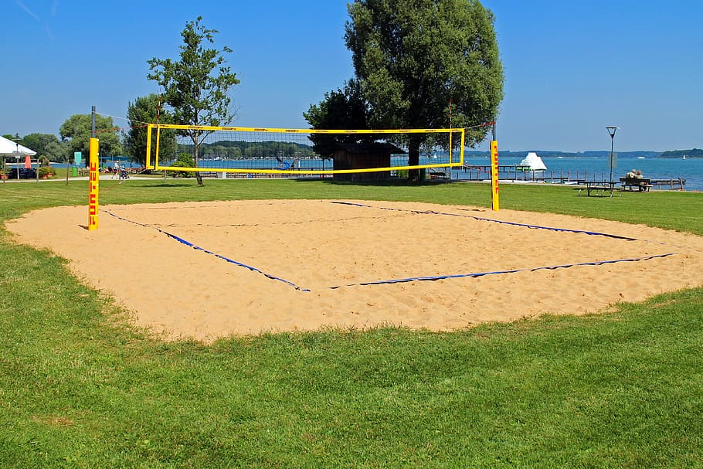
floor sand

Slide 8
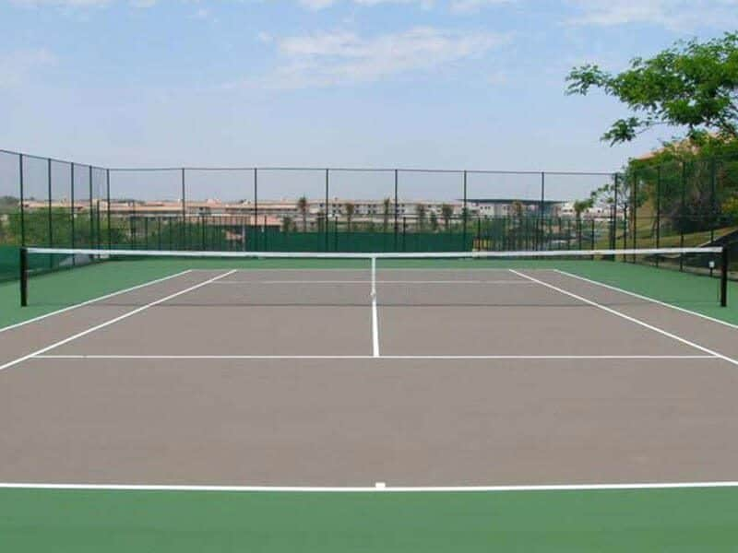
floor material volley ball court

Slide 9
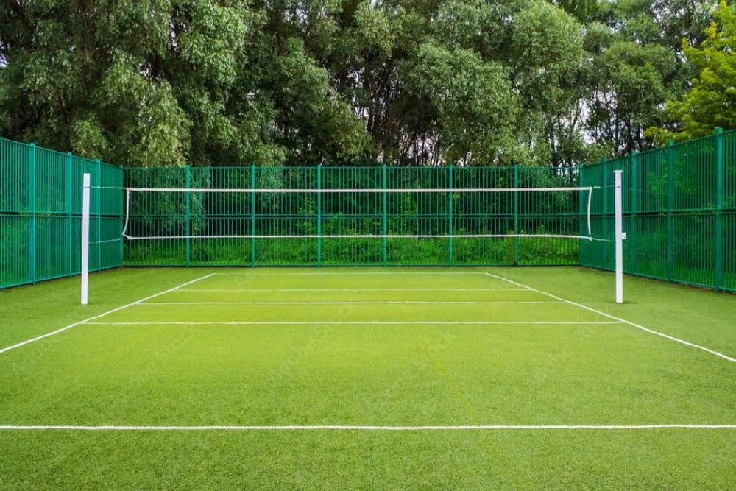
floor grass volley ball court design

Slide 10
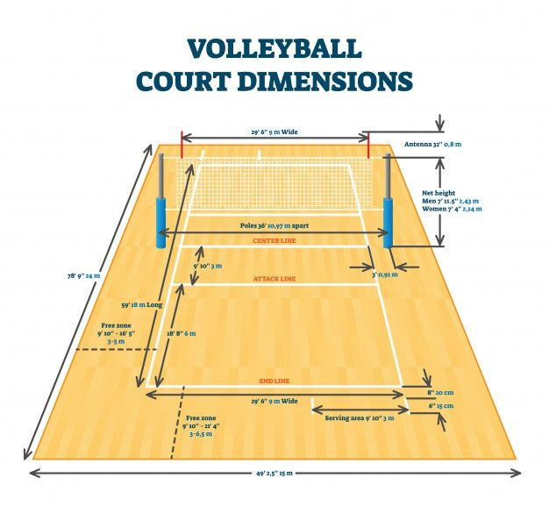
floor markers

Slide 11
volley ball court Floor cleanups equipments

Slide 12
Fencing design
Types of polls
INDOOR VOLLEYBALL POLES
OUTDOOR VOLLEYBALL POLES

Slide 13
no.of polls

Slide 14
position of polls

Slide 15
Types of nets
Carbon Volleyball Poles
Aluminum Volleyball Poles
Steel Volleyball Poles

Slide 16
no of nets
Net Height for Men : 2.43m (7.11F)
Net Height for women : 2.24m (7.4F)

Slide 17
position of nets
The net is vertical over the middle of court.
The top is set at 2.43m for men and 2.24m for women.

Slide 18
length of nets
2.43m high for men
2.24m high for women.

Slide 19
top roof for rain season

Slide 20
cover items

Slide 21
types of items
The three disciplines of modern fencing are the foil, the épée, and the sabre (also saber)

Slide 22
Covering type flexible (open and close)

Slide 23
Surronding water flow
Type of fixes
Single fixes
Cumulative PTF packages
Fix groups
Service packs

